Slide 1

Generative AI

Slide 2
Module 2
Transformers

Slide 3
Introduction to Transformers
Transformer Architecture
Pre-trained Checkpoints
Applications of Transformers
Hands-on - Hugging Face & Generative AI

Slide 4
Introduction to Transformers

Slide 5

Introduction to Transformers
What is the first thing that comes to mind when we say transformers?

Slide 6

Introduction to Transformers
Well, you are not to blame, it is a great franchise. But transformers are not the earth’s savior from apocalyptic space events.

Slide 7
Introduction to Transformers
Let’s understand how the need for transformers occurred and what they really are.

Slide 8
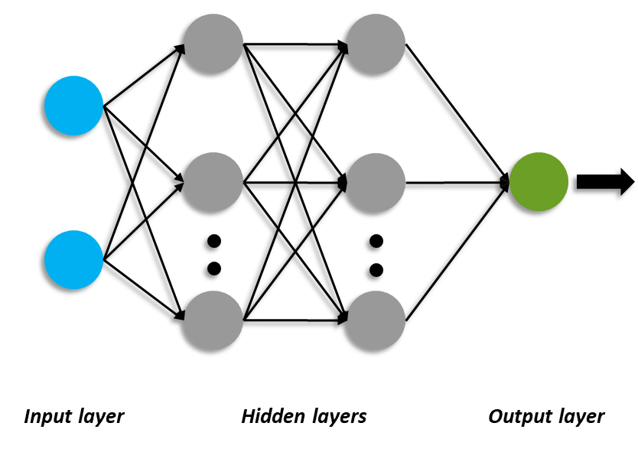
Introduction to Transformers
When we talk about neural networks, we simply have a structure where there is some input, great deal of hidden layers that translates into an output.

Slide 9


Introduction to Transformers
we have CNN's that work great for applications of deep learning that includes images.
Cat
Dog

Slide 10
Introduction to Transformers
When it comes to the text data, we had mainly 2 options
RNN
LSTM

Slide 11
Introduction to Transformers
But what are the problems that used to occur with these options?
RNN
LSTM
RNNs process the data sequentially that makes it less efficient where the position of the text is important for analysis
The LSTM does take care of context from the previous text but is computationally very slow when it comes larger texts to process

Slide 12
Introduction to Transformers
So what are transformers then?

Slide 13

Introduction to Transformers
Transformers are deep neural networks that use a encoder decoder architecture and process large texts using positional encoding and self-attention mechanism.

Slide 14
Introduction to Transformers
What is this self-attention and positional encoding that sets transformers apart. Let’s understand this with a simple example.

Slide 15
Introduction to Transformers
Positional Encoding does the job of preserving the order of sequences in the text data. The positional encodings provide the following features
Preserving the sequence order
Maintaining contextual information
Enhances Generalization
Mitigation summary

Slide 16
Introduction to Transformers
Self-Attention Mechanism is used mainly in natural language processing tasks that captures the dependencies and other relationships between the input embeddings. The primary goal of the self attention mechanism is to identify the importance of different parts of the input sequence by attending to itself

Slide 17
Introduction to Transformers
Let’s understand the architecture of the transformers and how it works.

Slide 18
Transformer Architecture

Slide 19
Transformer Architecture
To understand the transformer architecture, we first need to understand the encoder and decoder architecture that makes the transformer.

Slide 20
Transformer Architecture
Encoder-Decoder Architecture - To simplify, Let’s say we want to perform a simple translation task using the transformer. So here we have an input that goes through the transformer and we get the output from the encoder-decoder model.
Hello World!
Bonjour le monde!
Features
Encoder
Decoder
Input
Output
Transformer

Slide 21
Transformer Architecture
Let’s dig a little deeper and understand the working of the encoder and decoder architecture

Slide 22
Transformer Architecture
Now what happens is that the encoder architecture consists of several other encoders where the input is processed and the output of the last encoder is passed to the decoder
Hello World!
Features
Encoder
Encoder
Encoder
Encoder
Encoder
Encoder
Input

Slide 23
Transformer Architecture
Similarly, the decoder also consists of various other decoder modules through which the features are passed for the desired output.
Bonjour le monde!
Features
Decoder
Decoder
Decoder
Decoder
Decoder
Decoder
Input

Slide 24
Transformer Architecture
Each decoder block receives the features from the encoder block
Features
Input
Encoder
Decoder
Output
Nx
Nx

Slide 25
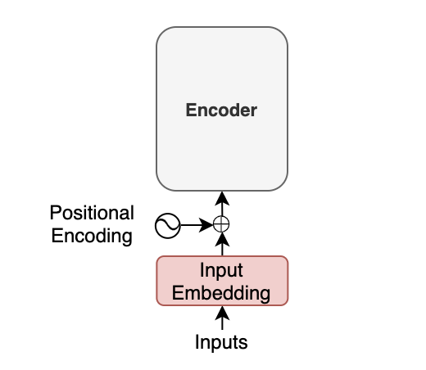
Transformer Architecture
Now let’s consider input embeddings and positional encoding and how they play their part in the transformer architecture. These are the following steps that are followed:
The words in the sentences are tokenized using tokenizers and converted into word embeddings.
For example - if the model uses a 512-dimensional vector for embeddings, a 200 word sentence will become (200,512) in shape.
Positional encoding is injected to each word embeddings to identify positions without recurrence.
The sequence of the embedding vectors represent the positions and semantics of the token.

Slide 26
Transformer Architecture
(‘Hello’, ‘world’, ‘!’, <pad>, <pad>, …, <pad>)
The words of input are tokenized and the tokenized sentence is a fixed-length sequence. In the above example, the padding has been added for a max length sentence of 200.

Slide 27
Transformer Architecture
(8667, 1362, 106, 0, 0, …, 0)
The tokenized sentences are integer indices, so the tokenized array would look like shown in the example. The number - 8667 corresponds to Hello. After the tokenization is done, the embedding vectors enriched with positional embedding is added to sequence for it to go to the encoder architecture.

Slide 28
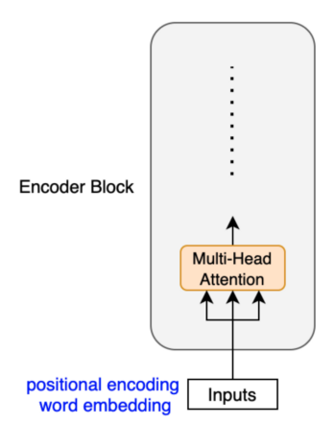
Transformer Architecture
At this stage, the encoder will use the self attention mechanism to enrich the tokens with contextual information
The self-attention mechanism employs multiple heads, since each token may have multiple semantics/function, the model taps into different embedding subspaces

Slide 29
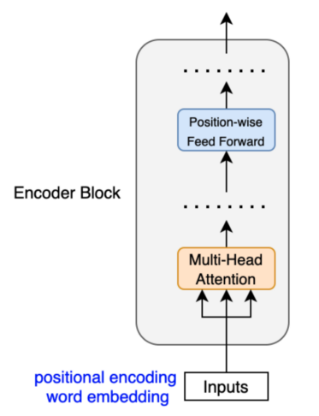
Transformer Architecture
The position wise feed forward network has a linear layer, a ReLU and another linear layer, where each vector embeddings are processed independently
Although the weights in the FFN are same across all positions in each layer, the embeddings go through dimensionality expansion.
The dimensionality expansion introduces non-linearity without losing much information and helps in preserving more information from the embedding vectors.

Slide 30
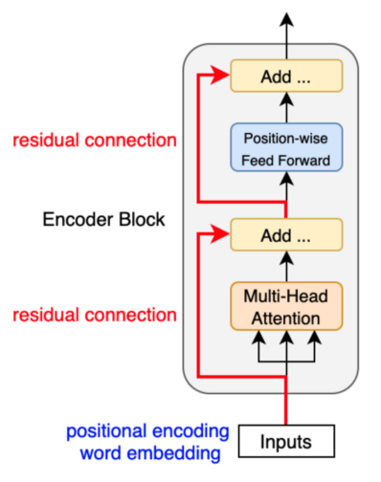
Transformer Architecture
Encoder block uses element wise addition i.e residual connection
Residual connections carry over the previous embeddings to the subsequent layers.
The encoder blocks enrich the embedding vectors with additional information obtained from the multi-head self-attention and position-wise feed-forward networks

Slide 31
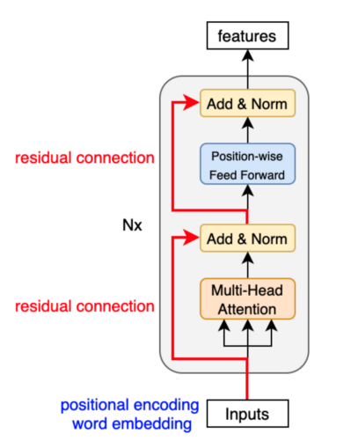
Transformer Architecture
After each residual connection, there is a layer normalization.
This step helps in maintaining the mean and standard deviation of the embedding vectors that in turn helps in training
Unlike batch normalization, each embedding vector is normalized

Slide 32
Transformer Architecture
Now that we know, how the encoder works, let us also understand how the data reached the decoder and how it actually works.

Slide 33
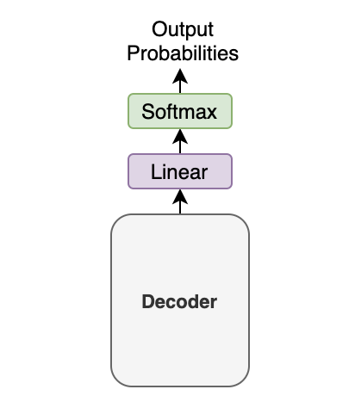
Transformer Architecture
The decoder block receives the enriched embeddings with positional encoding from the encoder. After this, the decoder will process the vectors in the following ways:
The decoder outputs one token at a time
a previous output from the decoder becomes the last part of the next input to the decoder i.e auto-regressive approach
To initiate the translation, the decoder passes an <sos> start of sentence marker
Multiple decoder blocks adds the contextual information from the features
The output vector also goes through linear transformations and the softmax layer further converts the vector into output probabilities

Slide 34
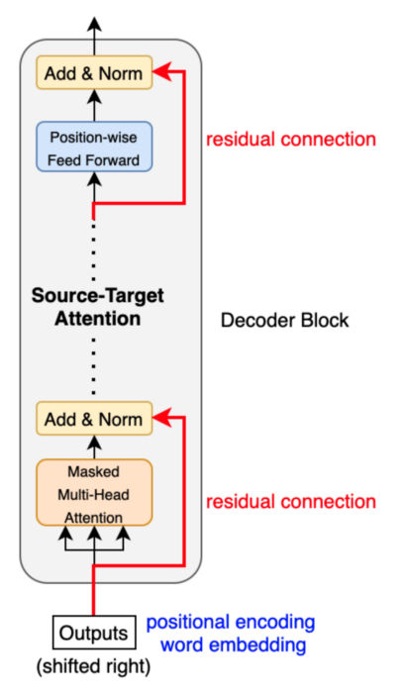
Transformer Architecture
The decoder block works similar to the encoder block, only it focuses on the source-target attention

Slide 35
Transformer Architecture
Masked multi-head attention means receives input that has masked values and do not use those values from the hidden positions.
The softmax within the attention mechanisms effectively assigns zero probability to masked positions

Slide 36
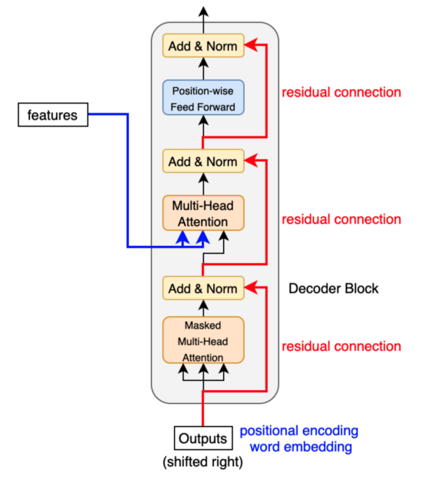
Transformer Architecture
The source-target attention is another multi-head attention that calculates the attention values between the features (embeddings) from the input sentence and the features from the output (yet partial) sentence.

Slide 37
Pre-trained Checkpoints

Slide 38
Pre-trained Checkpoints
What are pre-trained checkpoints?

Slide 39
Pre-trained Checkpoints
Let’s take an example to understand pre-trained checkpoints

Slide 40

Pre-trained Checkpoints
Let’s suppose a few professionals start building a wall

Slide 41

Pre-trained Checkpoints
Even if they are not able to finish the wall on day 1, they will come on the next day to finish the wall. The checkpoints work similar to this principal.
A checkpoint is a saved version of a model during training.

Slide 42
Pre-trained Checkpoints
Advantages of Pre-trained Checkpoints
Resuming Training
Fine Tuning
Model Evaluation
Deployment
Resume your training from a saved checkpoint
Using the saved checkpoints to custom train on new data for specific tasks
Use the checkpoints to evaluate your model on validation and test data
Save the final trained model checkpoint for later use

Slide 43
Applications of Transformers

Slide 44
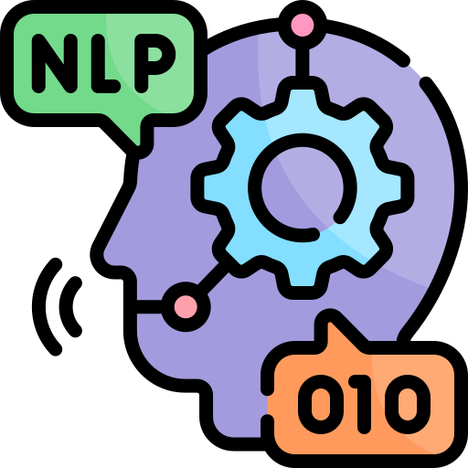




Applications of Transformers
Natural Language
Processing
Computer
Vision
Audio Processing
and Applications
Transformers help in text generation, summarization, translation, etc
Generation of images is one of the most famous applications of transformers
Processing audio for speech-to-text, text-to-speech using transformers
Deep Reinforcement Learning
3D Modeling
Reinforcement learning using transformers for training custom models without the dependency of existing data
Modeling 3D deliverables using transformers

Slide 45
Hands-On: Hugging Face and Generative AI

Slide 46


